Slide 1
Fundamentals of Python: First Programs Second Edition
Chapter 6
Design with Functions

Slide 2
Defining Simple Functions
Defining our own functions allows us to organize our code in existing scripts more effectively
This section provides a brief overview of how to do this
Function: group of statements within a program that perform as specific task
Usually one task of a large program
Functions can be executed in order to perform overall program task
Known as divide and conquer approach
Modularized program: program wherein each task within the program is in its own function
def area(r):
#Returns the area of a circle
area = 3.1415 * r **2
return area

Slide 3
Benefits of Modularizing a Program with Functions
The benefits of using functions include:
Simpler code
Code reuse
write the code once and call it multiple times
Better testing and debugging
Can test and debug each function individually
Faster development
Easier facilitation of teamwork
Different team members can write different functions

Slide 4
Defining and Calling a Function
Function names must follow the same rules as variable names
Function name should be descriptive of the task carried out by the function
Often includes a verb
Function definition: specifies what function does
def function_name():
statement
statement
The function header is the first line of the function. It has def and the function name.
The function body (or block) is the set of statements indented inside the function

Slide 5
Defining and Calling a Function (cont’d.)
The statements inside the function will not execute unless the function is called.
The function is often called inside the main function
When a function is called the program jumps over to its block and executes all of the statements inside the function.
Then the program jumps back to where it was. (Known as function return)
import math
def area(r):
#Returns the area of a circle
area = math.pi * r **2
return area
radius = 10.0
a = area(radius)
print("Area of a circle with radius %f is %f" % (radius, a))

Slide 6
Void Functions and Value-Returning Functions
A void function:
Simply executes the statements it contains and then terminates.
You could include a return statement with nothing beside it in a void function
def printMessage():
print(“This is a sample print statement.”)
A value-returning function:
Executes the statements it contains, and then it returns a value back to the statement that called it. The input, int, and float functions are examples of value-returning functions.
def square(x):
y = x**2
return y

Slide 7
Local Variables
Scope: the part of a program in which a variable may be accessed
For local variable: function in which created
Local variable: variable that is assigned a value inside a function
Belongs to the function in which it was created
Only statements inside that function can access it, error will occur if another function tries to access the variable
Different functions may have local variables with the same name
Each function does not see the other function’s local variables, so no confusion

Slide 8
Local Variables (cont’d.)
import math
def calcArea(radius): area = math.pi * radius ** 2 return area
def calcVolume(radius): volume = math.pi * radius ** 3 return volume
rad = float(input("Please enter the radius: ")) a = calcArea(rad) v = calcVolume(rad) print("Radius: %0.2f, Area: %0.2f, Volume: %0.2f" % (rad,a,v))

Slide 9
Global Variables
Global variable: created by assignment statement written outside all the functions
Can be accessed by any statement in the program file, including from within a function
If a function needs to assign a value to the global variable, the global variable must be redeclared within the function
General format: global variable_name

Slide 10
Global Variables (cont’d.)
Reasons to avoid using global variables:
Global variables make debugging difficult
Many locations in the code could be causing a wrong variable value
Functions that use global variables are usually dependent on those variables
Makes function hard to transfer to another program
Global variables make a program hard to understand

Slide 11
Parameters and Arguments
A parameter is the name used in the function definition for an argument that is passed to the function when it is called
The scope of a parameter is the function in which it is used
For now, the number and positions of arguments of a function call should match the number and positions of the parameters in the definition
Some functions expect no arguments
They are defined with no parameters, but they still must have the () beside them
#function call in the main section of code
value = 5
show_double(value)
def show_double(number):
result = number * 2
print(result)
Functions can have multiple parameters
def calcVolume(len, wid, ht):
volume = len * wid * ht
return volume

Slide 12
Pass by Reference or by Value
If a parameter is int, float or string, then it will be passed by value. This means that the function receives a copy of the parameter sent into it.
Thus, if the parameter is changed in the function, it will not be changed back in the calling function.
Lists and dictionaries can also be used as parameters. They are passed by reference. That means that the function will be using the original list or dictionary, not a copy.
Therefore, if the parameter is changed in the function, it will also be changed back in the main function (or calling function).

Slide 13
Pass by Value
def doMath(x, y):
a = x + y ** 2
x = 0
y = 0
return a
s = 10
t = 5
u = doMath(s, t)
print ("s: %d, t: %d, u: %d" % (s, t, u))
Output:
s: 10, t: 5, u: 35

Slide 14
Pass by Reference
def doMath(xList):
total = 0
for x in xList:
total = total + x
xList[0] = 1
xList[1] = 1
return total
list = [5, 10, 15, 20, 25]
print("Original list is", list)
t = doMath(list)
print("Total is %d \n" % t)
print("New list is", list)
Output:
Original list is [5, 10, 15, 20, 25]
Total is 75
New list is [1, 1, 15, 20, 25]

Slide 15
The Return Statement
Place a return statement at each exit point of a function when function should explicitly return a value
Syntax:
return <expression>
If a function contains no return statement, Python transfers control to the caller after the last statement in the function’s body is executed
The special value None is automatically returned

Slide 16
Returning Multiple Values
In Python, a function can return multiple values (Crazy stuff!!!!)
Specified after the return statement separated by commas
Format: return expression1, expression2, etc.
When you call such a function in an assignment statement, you need a separate variable on the left side of the = operator to receive each returned value
def calcVolume(radius):
volume = math.pi * radius ** 3
area = math.pi * radius ** 2
return volume, area
rad = float(input("Please enter the radius: "))
v,a = calcVolume(rad)
print("Radius: %0.2f, Area: %0.2f, Volume: %0.2f" % (rad,a,v))

Slide 17
Boolean Functions
A Boolean function usually tests its argument for the presence or absence of some property
Returns True if property is present; False otherwise
Example:
def odd(x):
""" Returns True if x is odd or False otherwise."""
if x % 2 == 1:
return True
else:
return False
>>> odd(5)
True
>>> odd(6)
False

Slide 18
Defining a Main Function (1 of 2)
main serves as the entry point for a script
Usually expects no arguments and returns no value
Definition of main and other functions can appear in no particular order in the script
As long as main is called at the end of the script
Script can be run from I D L E, imported into the shell, or run from a terminal command prompt
NOTE: For any programs that have functions in future labs, you will need to have a main function that is started as shown on the next slide with the 2 statements at the bottom:
if __name__ == "__main__"
main()

Slide 19
Defining a Main Function (2 of 2)
Example:
"""
File: computesquare.py
Illustrates the definition of a main function.
"""
def main():
""" The main function for this script."""
number = float(input("Enter a number: "))
result = square(number)
print("The square of", number, "is", result)
def square(x):
"""Returns the square of x."""
return x * x
# The entry point for program execution
if __name__ == "__main__":
main()

Slide 20
Functions Eliminate Redundancy
Functions serve as abstraction mechanisms by eliminating redundant, or repetitious, code
def summation(lower, upper):
"""Arguments: A lower bound and an upper bound
Returns: the sum of the numbers from lower through upper
"""
result = 0
while lower <= upper:
result += lower
lower += 1
return result
>>> summation(1,4) # The summation of the numbers 1..4
10
>>> summation(50,100) # The summation of the numbers 50..100
3825

Slide 21
Functions Hide Complexity
Functions serve as abstraction mechanisms is by hiding complicated details
For example, consider the previous summation function
The idea of summing a range of numbers is simple; the code for computing a summation is not
A function call expresses the idea of a process to the programmer
Without forcing him/her to wade through the complex code that realizes that idea

Slide 22
Problem Solving with Top-Down Design
Top-down design starts with a global view of the entire problem and breaks the problem into smaller, more manageable subproblems
Process known as problem decomposition
As each subproblem is isolated, its solution is assigned to a function
As functions are developed to solve subproblems, solution to overall problem is gradually filled out
Process is also called stepwise refinement

Slide 23
Lifetime
Variable’s lifetime: Period of time when variable has memory storage associated with it
When a variable comes into existence, storage is allocated for it; when it goes out of existence, storage is reclaimed by the P V M
Module variables come into existence when introduced and generally exist for lifetime of program that introduces or imports them
Parameters and temporary variables come into existence when bound to values during call, but go out of existence when call terminates

Slide 24
The math Module
math module: part of standard library that contains functions that are useful for performing mathematical calculations
Typically accept one or more values as arguments, perform mathematical operation, and return the result
Use of module requires an import math statement

Slide 25
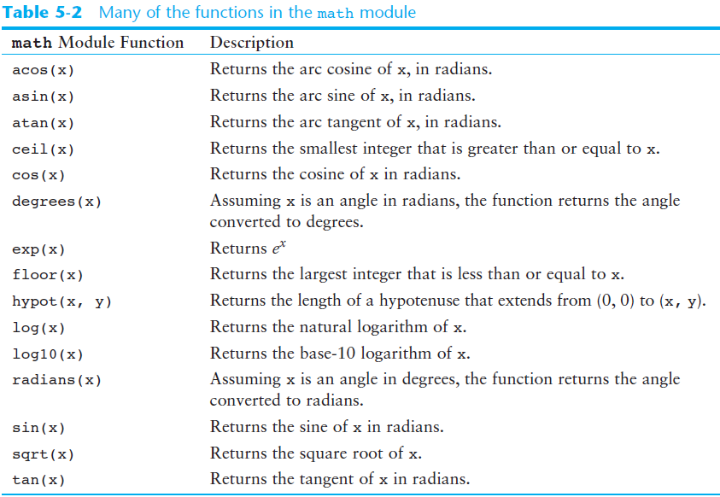
The math Module (cont’d.)

Slide 26
The math Module (cont’d.)
The math module defines variables pi and e, which are assigned the mathematical values for pi and e
Can be used in equations that require these values, to get more accurate results
Variables must also be called using the dot notation
Example:
circle_area = math.pi * radius**2

